Slide 1






Case Studies from Practice Seminar
Secure AI Code Assistants?
11/12/2024
Benefits of using AI Code Assistants
Fewer Errors
Fewer syntax issues, quick fixes.
Better Suggestions
Auto Documentation
Instant alternatives, rapid improvements.
Clear explanations, easier maintenance.
Accessible for All
Beginners learn faster, experts adapt quickly.
Fast Start
Ready templates, less repetition.
Smoother Workflow
Quick restarts, easy recall of details.
Notes:
AI code assistants offer many benefits. First, they help you get started quickly. If you’re stuck, you can simply ask, “Where should I begin?” The assistant can set up the basics of your project, so you can focus on the logic.
Another great feature is auto documentation. It creates clear explanations for the code, making it easier to review and maintain. If you make changes, it updates the documentation.
AI tools also help you avoid errors, like missing a semicolon. If there’s an error output, you can ask the assistant to fix it or handle exceptions.
They can also suggest better alternatives—whether that’s simpler code or something more efficient. This means you’re solving problems faster and coming to meetings prepared with solutions.
AI assistants are useful for everyone. Beginners get guidance, and experts can adapt quickly to new challenges.
Finally, they make it easy to return to your work. If you’re interrupted, you can review your last conversation or ask for a summary to get back into the flow.

Slide 2
Case Studies from Practice Seminar
Secure AI Code Assistants?
11/12/2024
AI-powered tools automate tasks and offer smart suggestions, increasing coding speed by 56%.¹
56%
Following standards and best practices with AI tools improves code consistency and reduces errors by 40%.²
40%
1
Source:https://www.cut-the-saas.com/ai/generative-ai-impact-on-developers-increased-productivity-and-faster-task-completion?t
https://devblogs.microsoft.com/visualstudio/introducing-github-copilot-x/
Notes:
Studies clearly show the impact of AI code assistants. They help developers work 56% faster, which could mean more coffee breaks—just kidding!
More importantly, these tools reduce errors by 40%, making debugging much easier. And the code becomes more consistent, with proper documentation and well-managed exceptions.

Slide 3










Case Studies from Practice Seminar
Secure AI Code Assistants?
11/12/2024
Risks of using AI Code Assistants
Privacy Leaks
Sensitive business logic is unknowingly uploaded to an AI service.
Logic Errors
A developer used ChatGPT for a compound interest Algorithm, resulting in incorrect calculations.
Security Oversights
Failure to properly clean user inputs or protect personal data. (DEMO: Path Vulnerability)
Compatibility Security Issues
Code from an old version causes issues when run on even older version.
Overreliance on AI
Junior developers blindly accepting AI suggestions, without verification and produce buggy and insecure code.
Notes:
Let’s move on to the risks of using AI code assistants.
First, privacy leaks. Imagine a pharma-company uploading a secret formula online. That would be a disaster!
Next, logic errors. The code might run without errors but still do the wrong thing—like calculating compound interest incorrectly. This shows how important it is to use the right prompts when working with AI.
Then, there are security oversights. Sensitive data might not be encrypted, or user inputs might not be properly validated. These issues can create vulnerabilities, like the path traversal attack we saw in the demo, or risks like SQL injection and cross-site scripting.
Another risk is compatibility issues. If the code is used on older systems, important security features might be missing.
Finally, overreliance on AI. This happens when developers, especially junior ones, blindly trust AI’s suggestions.

Slide 4




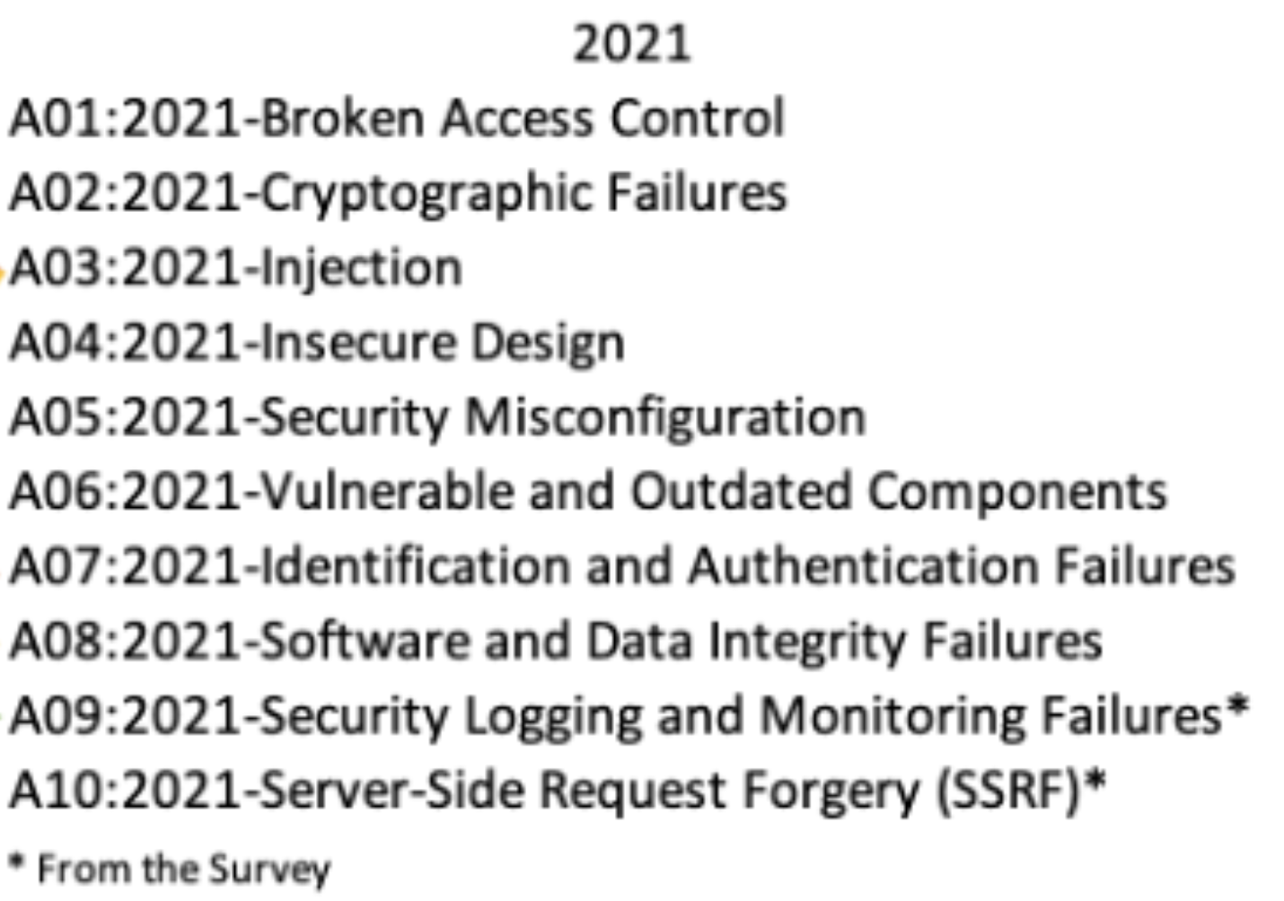

Case Studies from Practice Seminar
Secure AI Code Assistants?
11/12/2024
Education About Security Best Practices
OWASP Top 10
SANS CWE TOP 25
GitHub Advisory Database
Overview of common web application vulnerabilities.
A list of the most critical software weaknesses.
A database of security advisories for open-source projects.
OWASP Cheat Sheet
A collection of quick references for security best practices.
Notes:
To handle security risks, we need the right resources.
The OWASP Top 10 lists common issues like injection attacks and broken access control. If you need something quick, use the Cheat Sheet.
For critical software weaknesses, the CWE Top 25 highlights big problems like buffer overflows.
Lastly, the GitHub Advisory Database helps you track vulnerabilities in open-source projects and dependencies.
These tools aren’t funny to read, but they’re super helpful—and make it easier to work with AI tools by giving you the right knowledge for prompts.

Slide 5
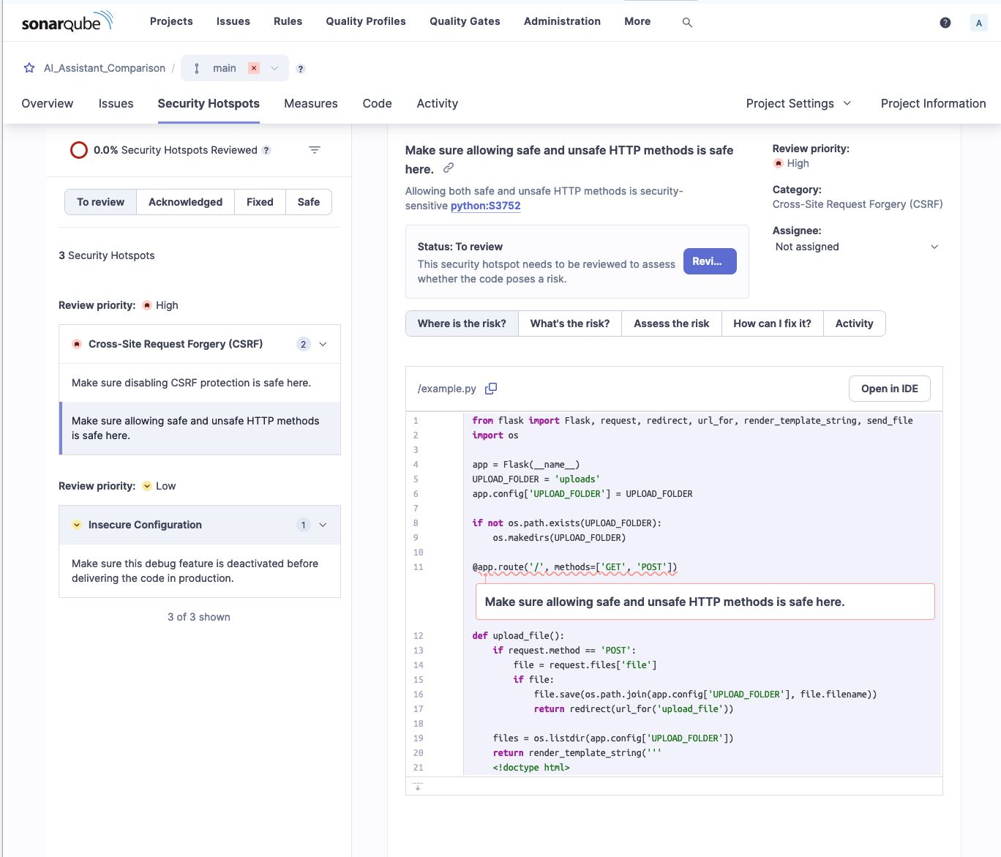
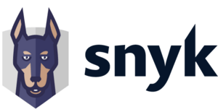

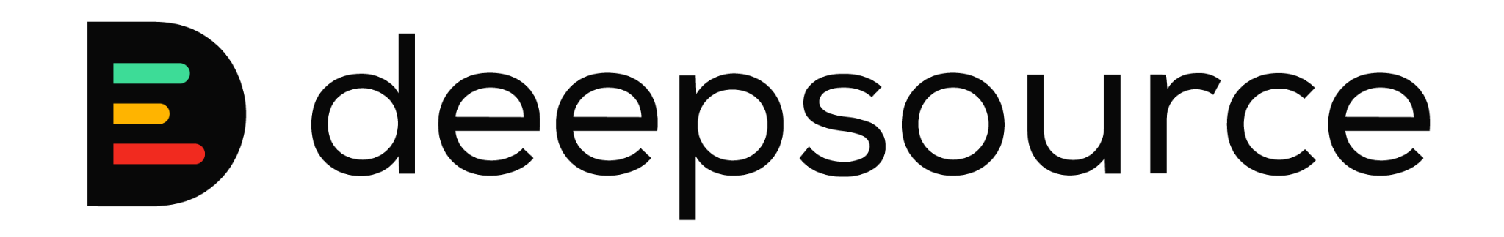
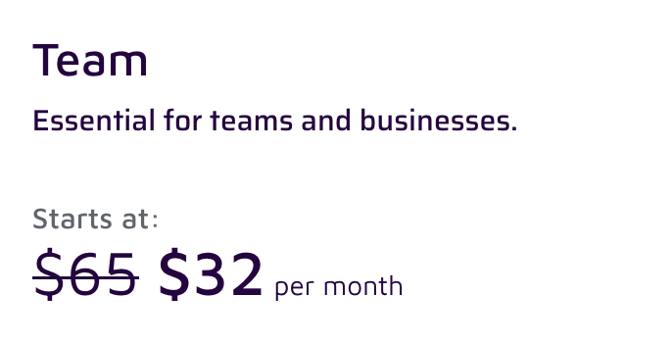
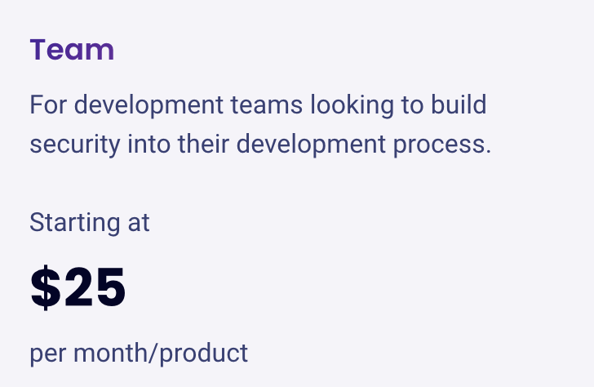
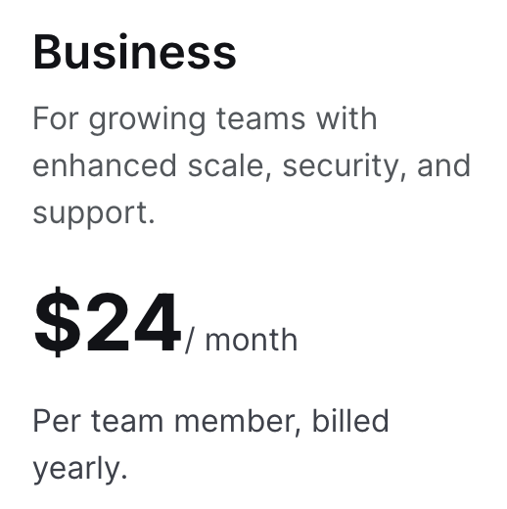



Case Studies from Practice Seminar
Secure AI Code Assistants?
11/12/2024
Static Code Analysis
In-depth code analysis
Attractive and informative UI with good visualisation tools
Time-consuming set-up
Can generate many false positives
Quick and easy to set up
Strong focus on security
Fast feedback
dedicated community
False positive rate below 5%
Fast feedback
Notes:
Using static code analysis tools is a bit like having insurance. Even the best and most expensive insurance can’t help if the driver isn’t paying attention.
We used three tools in our workflow, and you can see their prices on the slide.
First, there’s SonarQube. It’s the most expensive of the three but very powerful. It covers a lot—from security to code quality and maintainability. The UI is great, with beautiful visualizations. However, setting it up can be quite time-consuming—you’ll probably need a README to get through it. It’s also very strict, which sometimes means you’ll see many false positives.
Next is Snyk, and it’s my favorite. It’s quick and easy to set up and costs $25 per month, without requiring a yearly commitment like DeepSource. Snyk has a strong focus on security but also checks code quality and provides real-time feedback. I’ll show you a demo of this tool in a moment.
Finally, there’s DeepSource. This tool has an engaged community that updates its database. It has a low false-positive rate—less than 5%—and also provides fast, real-time feedback.

Slide 6
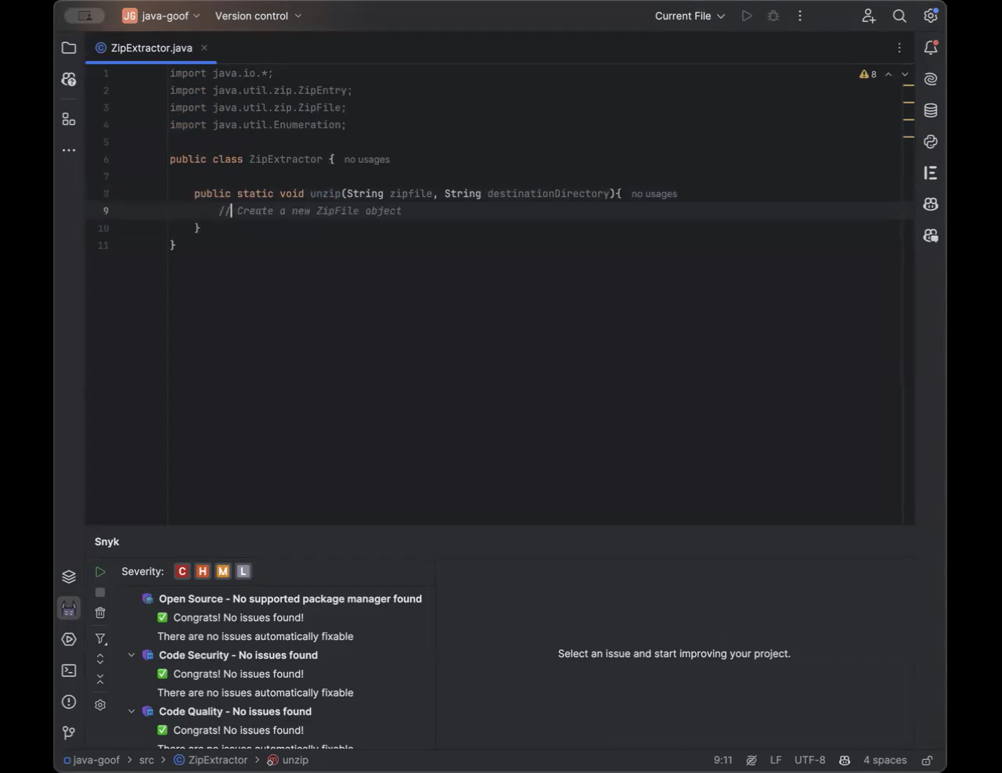
demo
1
AI tool generates code.
2
Snyk scans for vulnerabilities.
3
Snyk suggests fixes.
4
Developer applies fix.
Notes:
Here, I’ve implemented a small Java program called “ZipExtractor”. Using GitHub Copilot, I generated the code quickly and easily.
Next, Snyk scans the code in real-time for vulnerabilities. In this case, it found a path traversal issue.
Snyk provides recommendations to fix the issue. It suggests implementing an exception to ensure that the extracted file path doesn’t go outside the target directory.
In the final step, I applied this fix directly in the code.
And Voila, no security issues.

